Slide 1

Leading the Charge: Predicting the Demand for Electric Vehicles and Chargers in Washington State

Slide 2
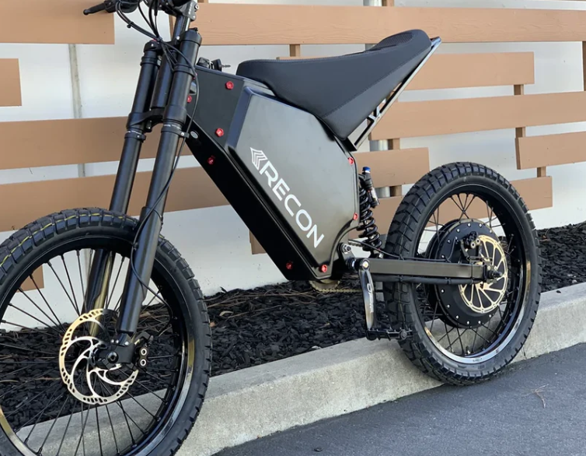
Table of Contents
Introduction
Obtain
SCRUB
Explore
Model
Interpret
Conclusions

Slide 3
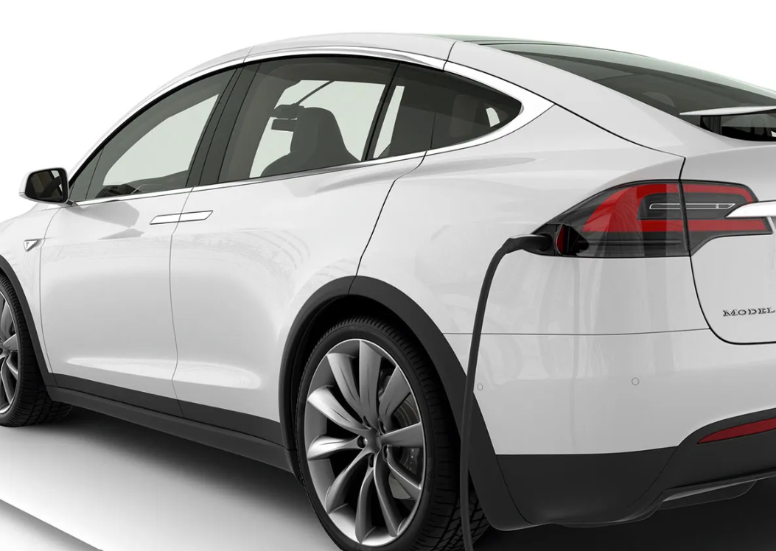
Introduction
The Problem
How will the current charging infrastructure of these states support an influx in demand for new EVs?
The U.S. is witnessing a significant shift towards electric vehicles (EVs) to combat transportation sector emissions, responsible for about 29% of the nation’s GHG emissions. With initiatives like President Biden's bipartisan infrastructure deal focusing on nationwide EV charger networks and states like California and Washington mandating EVs by 2035 and 2030, respectively, the move is gaining momentum. Major automakers are also transitioning to electric models within the next decade. This collective drive necessitates a major expansion of the current charging infrastructure to meet the expected rise in EV demand, ensuring that the infrastructure can support this green transition effectively.
M

Slide 4
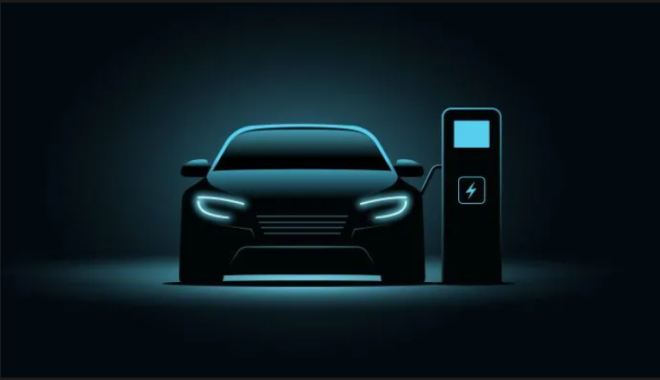
Business C ase
The Washington Department of Transportation is allocating $8 million towards expanding charging infrastructure from July 2021 to June 2023, presenting a lucrative opportunity for EV charging companies. By investing in Washington state, these companies can tap into government funding and capitalize on the growing demand for EV chargers. This strategic investment positions them well in a rapidly expanding market, aligning with the increasing shift towards electric vehicles.

Slide 5


Business Problem and Obtain
Business Problem
Obtain
In order to position electric vehicle chargers strategically, it is vital to model and predict the demand for electric vehicles in each county in Washington. In an effort to find counties that will have the most demand with the least amount of chargers, this analysis focuses on time series modeling of the amount of electric vehicles in the top 10 counties within Washington with the most purchases of new electric vehicles. Our goal is to recommend top 3 counties to invest in.
For our analysis we will be using the [electric vehicle title and registration activity data](https://data.wa.gov/Transportation/Electric-Vehicle-Title-and-Registration-Activity/rpr4-cgyd) provided by Washington state to calculate the amount of electric vehicles in each county over time. Additionally, in the Interpret section we will be looking at the [current charging infrastructure data](https://developer.nrel.gov/docs/transportation/alt-fuel-stations-v1/all/) provided by the National Renewable Energy Laboratory to find counties with the most potential for generating financial success.

Slide 6
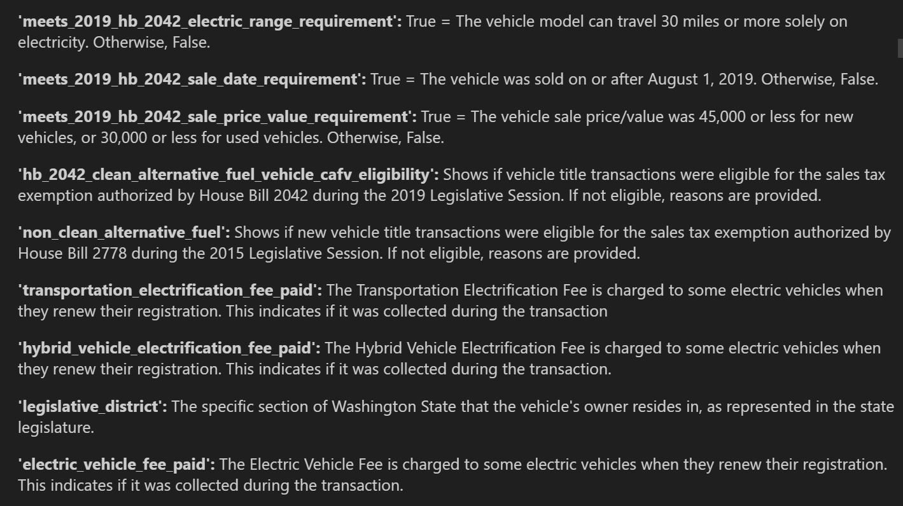
Column Exploration
Dropping Columns that are for Governmental Use
M

Slide 7
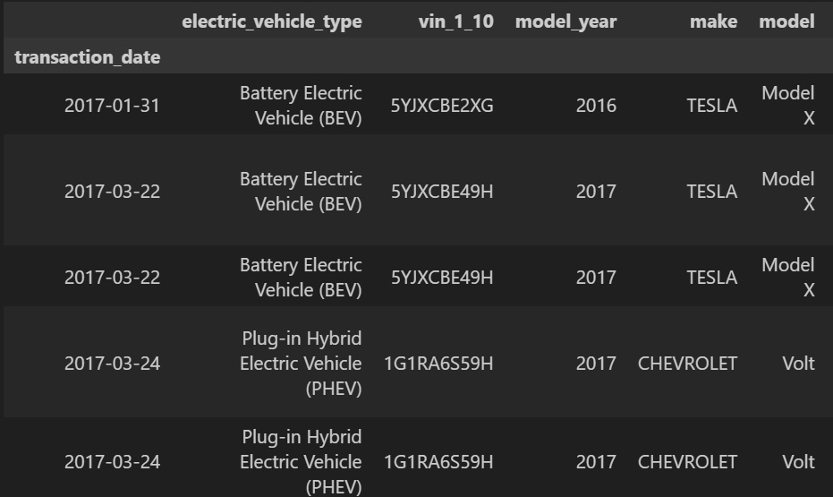
Dropping Columns with Redundant information
Column Information
Columns
Since we have the full transaction date in our index the 'transaction_year' column is redundant. Additionally, the date_of_vehicle_sale column seems to be missing quite a bit of information. Where there is data, the difference between the transaction date and the actual vehicle sale seems to be around a couple weeks so the difference is not meaningful for our purposes.
Also, we already have the sale price of the vehicle at the time of the transaction so the base MSRP column is irrelevant. So we can go ahead and drop these columns from our dataframe as well. We will be keeping the rest of the columns for the time being for EDA purposes.
m

Slide 8
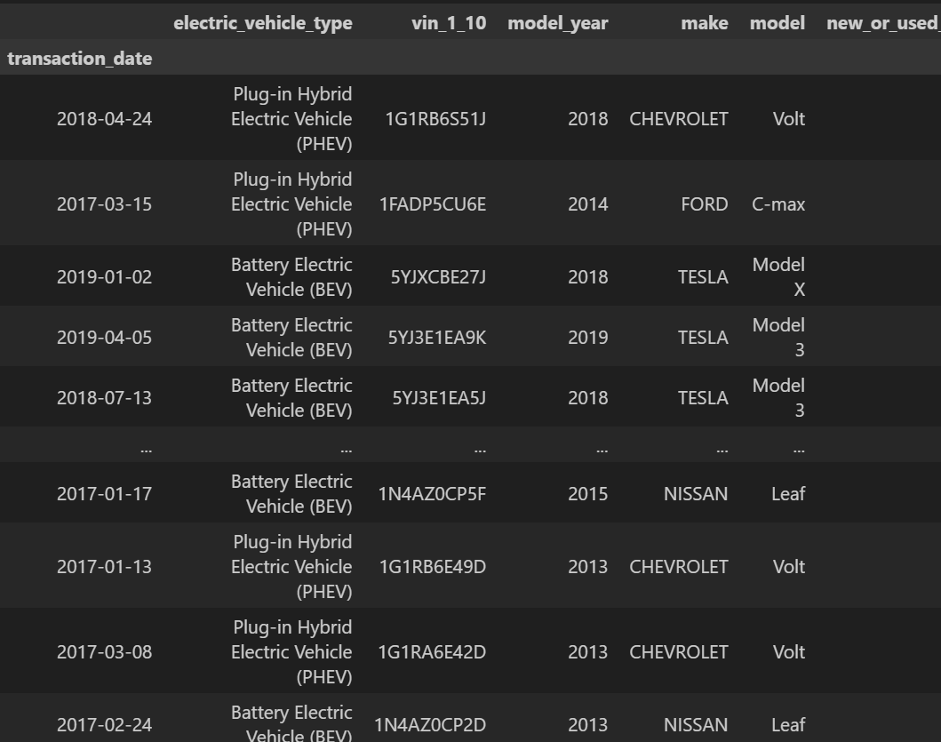
Addressing Duplicates
Now that we have a dataframe that shows only the purchases of new and used cars and none of the registration information, we can go ahead and address duplicates.
We have 1287 rows of data that are duplicated. In order to make sure that these are indeed duplicates with no differences we will inspect a few of the vehicles below:
Exact Duplicates

Slide 9
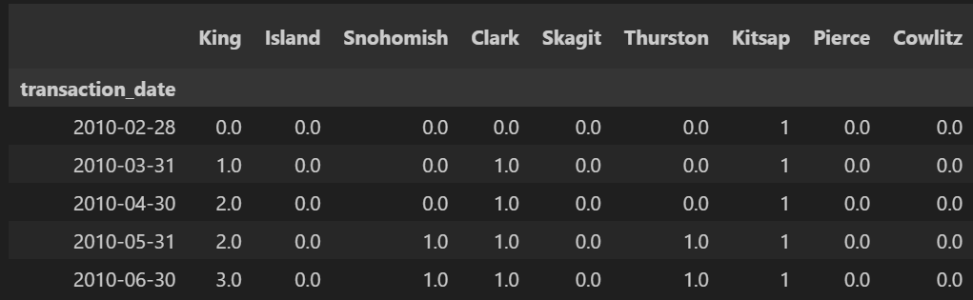
Explore
Filtering original title transactions by county
Electric vehicles on the road in Washington State Over Time
The goal of our analysis is to predict the amount of new electric vehicles joining the roads for each county over time. Therefore, we are only interested in the purchases of new vehicles and not the transactions for used vehicles. The currently "used" vehicles are still going to be represented in our dataset if they were initially purchased in the state of Washington. In order to find the number of cars on the road over time, we can take the cumulative sum of the monthly "Original Title" transactions for each county and parse this information into a dataframe.
Before we take a look at the electric vehicle trends for each county, it is important to see the larger picture by looking at the statewide trend.

Slide 10
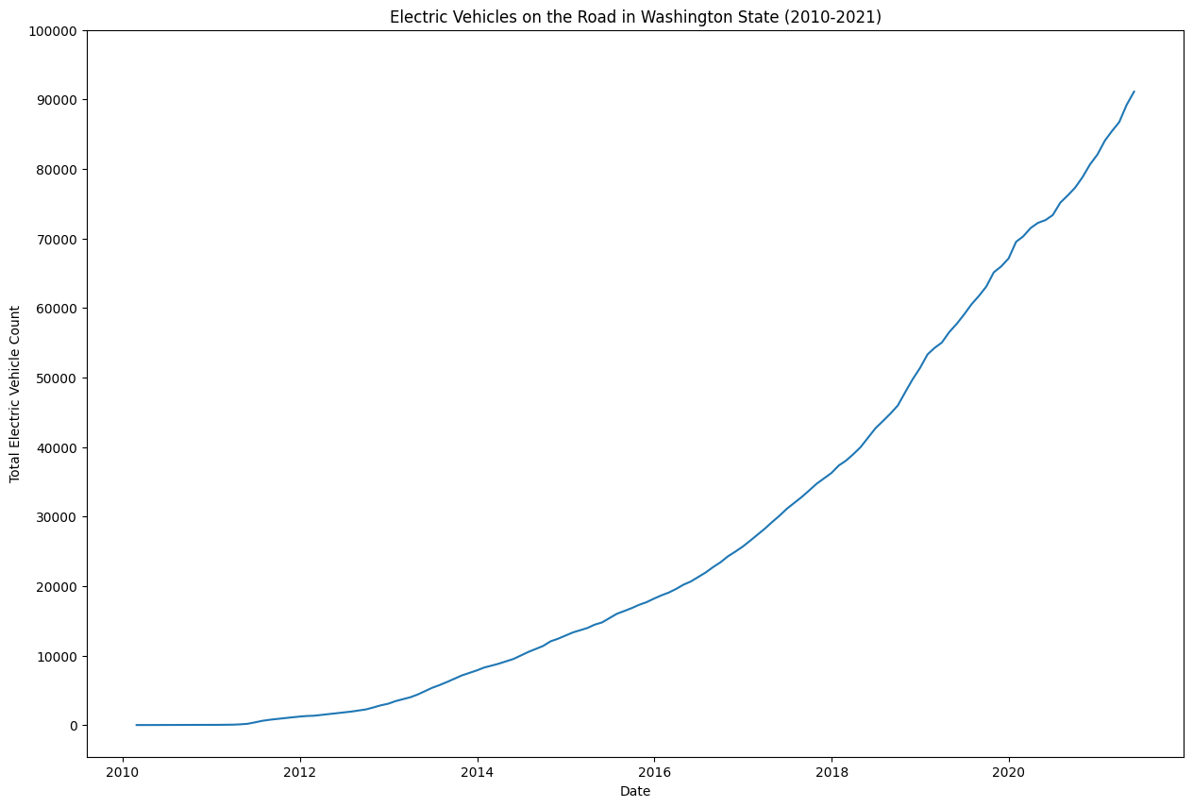
Electronic vehicles on the road
In Washington State (2010-2021)
As we can see above, the amount of electric vehicles on Washington State roads have been increasing exponentially over the past 10 years. On a high level, this confirms that Washington State has the necessary demand trend for electric vehicles to make investing in it profitable for an EV charging company. Since our data goes back as far as 2010, the count starts with 0 in 2010. However, it is important to note that this does not necessarily mean that there weren't any electric vehicles on the road in 2010. We are simply taking 2010 as our starting point and therefore the counts are relative.

Slide 11
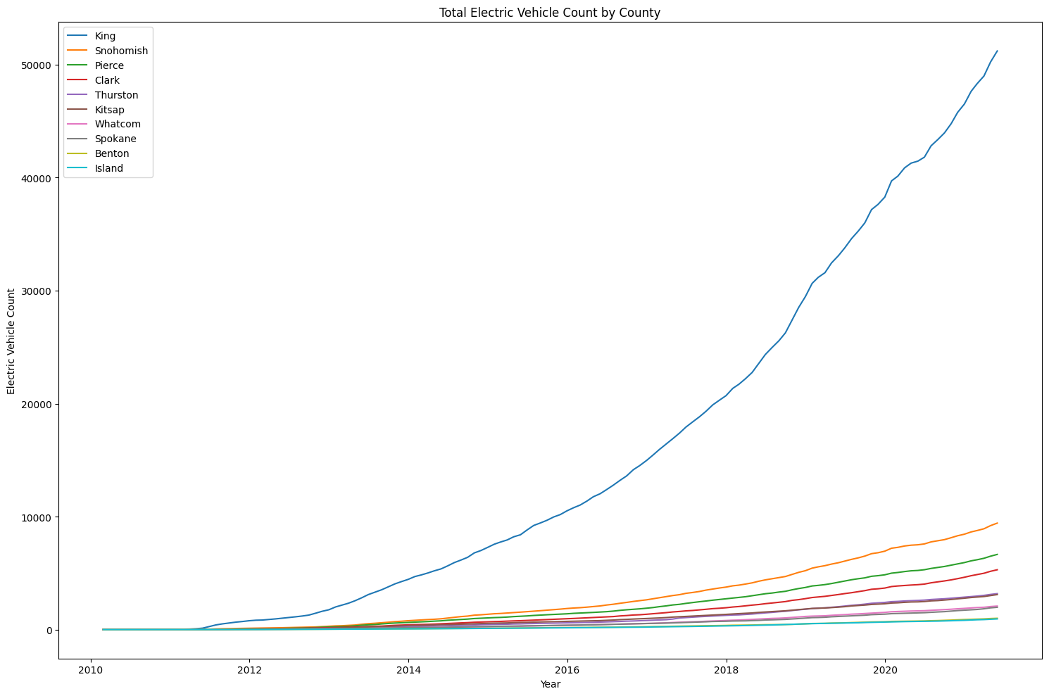
Electric Vehicles on the Road Over Time by County
Now that we looked at the statewide trend, we can start looking at individual counties. Since we have limited time for this analysis, we will be limiting our analysis to the top 10 counties that had the most electric vehicle purchases in the past 10 years.
Here, we can see that out of the top 10 most EV purchasing counties, King County has been growing much faster compared to others. This is expected since King County includes Seattle, which is the largest city by population in Washington State. Due to the scale differences between King County and the other 9 counties, it is difficult to see how these 9 counties compare to each other.

Slide 12
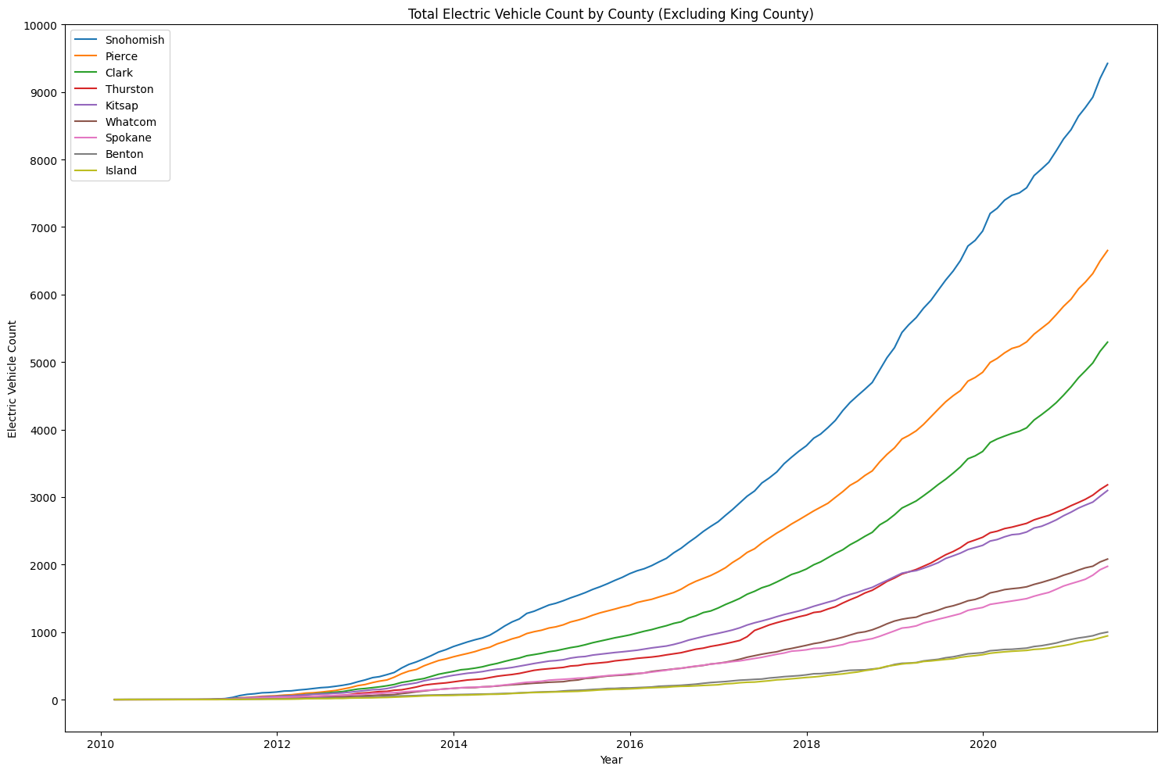
Electric Vehicles on the Road Over Time (Excluding King County)
When we exclude King County, we can see that Snohomish County is leading the charge in electric vehicle purchases followed by Pierce and Clark County.

Slide 13

Most Purchased Car Models by County
Another important piece of information that can be relevant for an electric charging company is what the most purchased electric vehicle models are in each of these counties to decide on additional factors. These may include: -
Whether to include adapters for different connector types (Tesla, CCS, CHAdeMO etc.)-
What kind of charging station to build (level 1, level 2, level 3)-
Spacing of chargers based on the size of vehicles

Slide 14
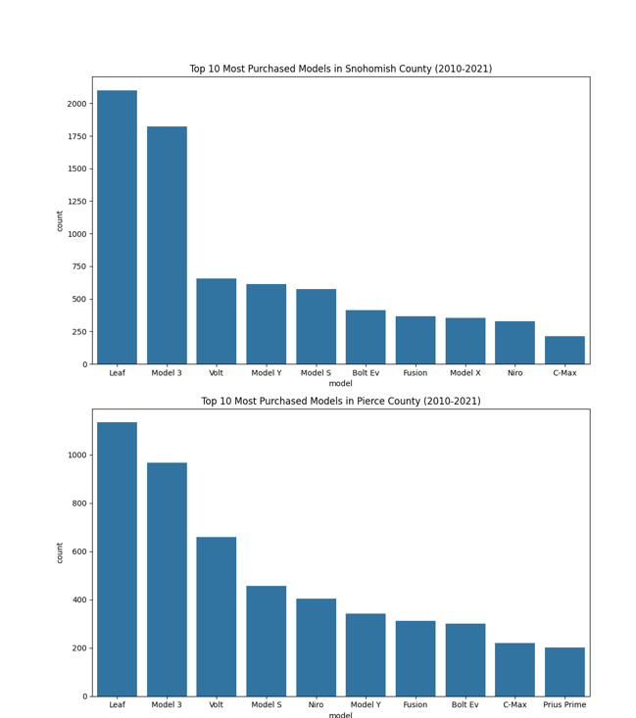
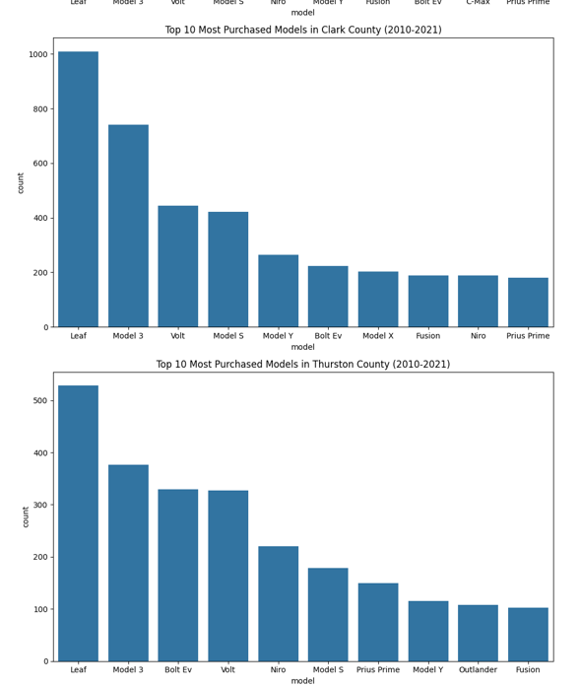

Slide 15
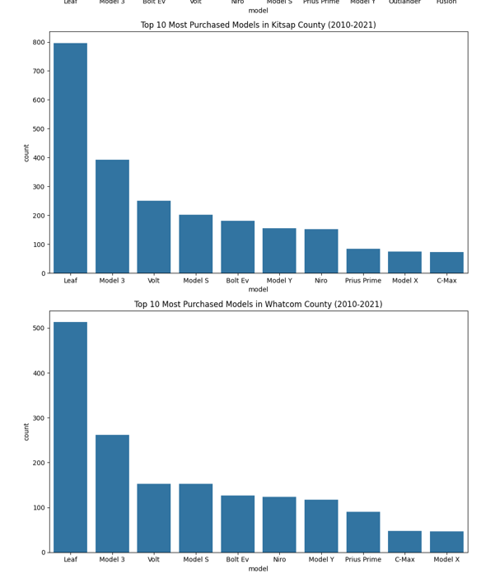
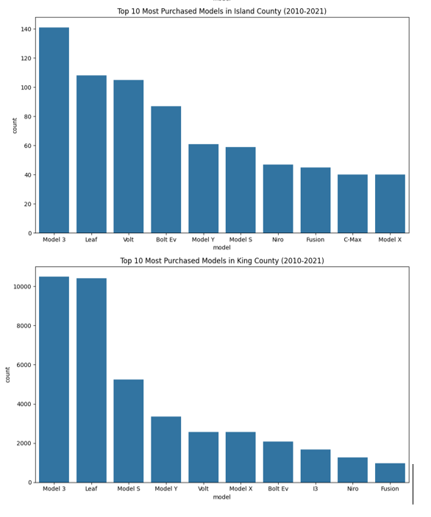

Slide 16
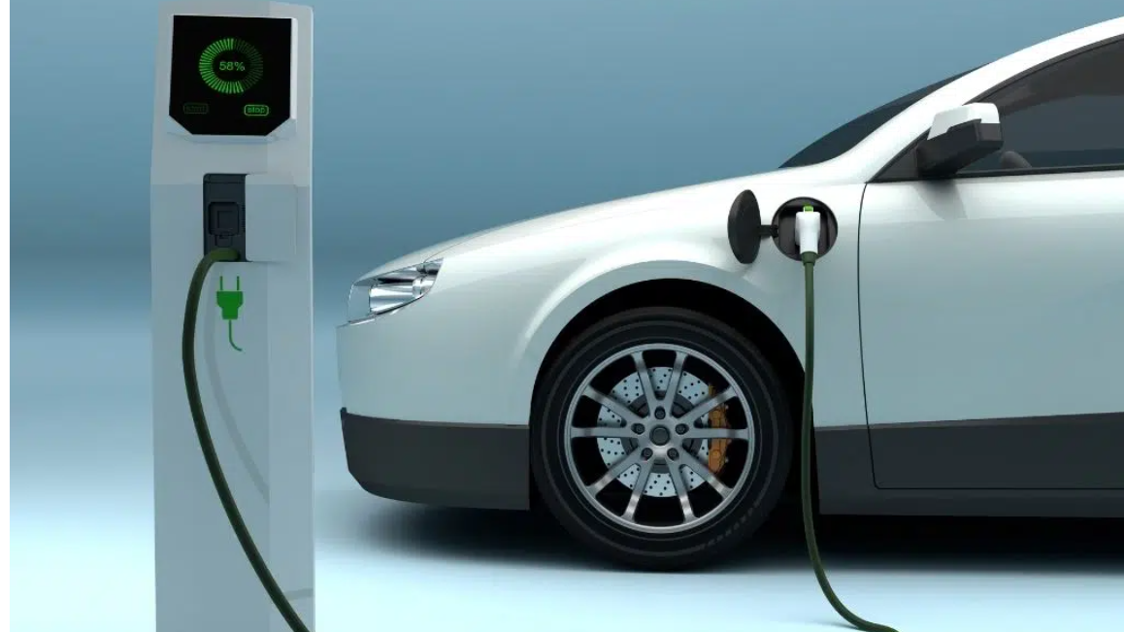
Nissan Leaf and Tesla Model 3 are the most purchased vehicles in each of these counties. Nissan Leaf was released in December 2010 and is widely considered to be the first mass-market electric vehicle. Tesla's Model 3 is a relatively lower priced luxury electric vehicle that was designed to appeal to the mass market as well. Considering these factors, it is not surprising that these vehicles are the most purchased vehicles in each county.

Slide 17
Model - Preprocessing/ Defining Functions
Separating Data for Each County
Functionizing the Evaluation of Models
As discussed above, we will be creating time series models for the top ten counties. This requires us to break down the dataframe we have into smaller dataframes for each county.
For validation purposes we will be getting the forecast from our model for the test period and will be plotting it against the actual test data.
Before modelling, one of the functions we will need is a function that will show us the various statistics so that we can evaluate the performance of the model.
We will be splitting the time series into two: a training set and a testing set. This will allow us to validate the performance of the models.
Lastly, we will also be needing a function similar to the get_forecast function that will be used for getting predictions for the future and plotting for visualization.

Slide 18
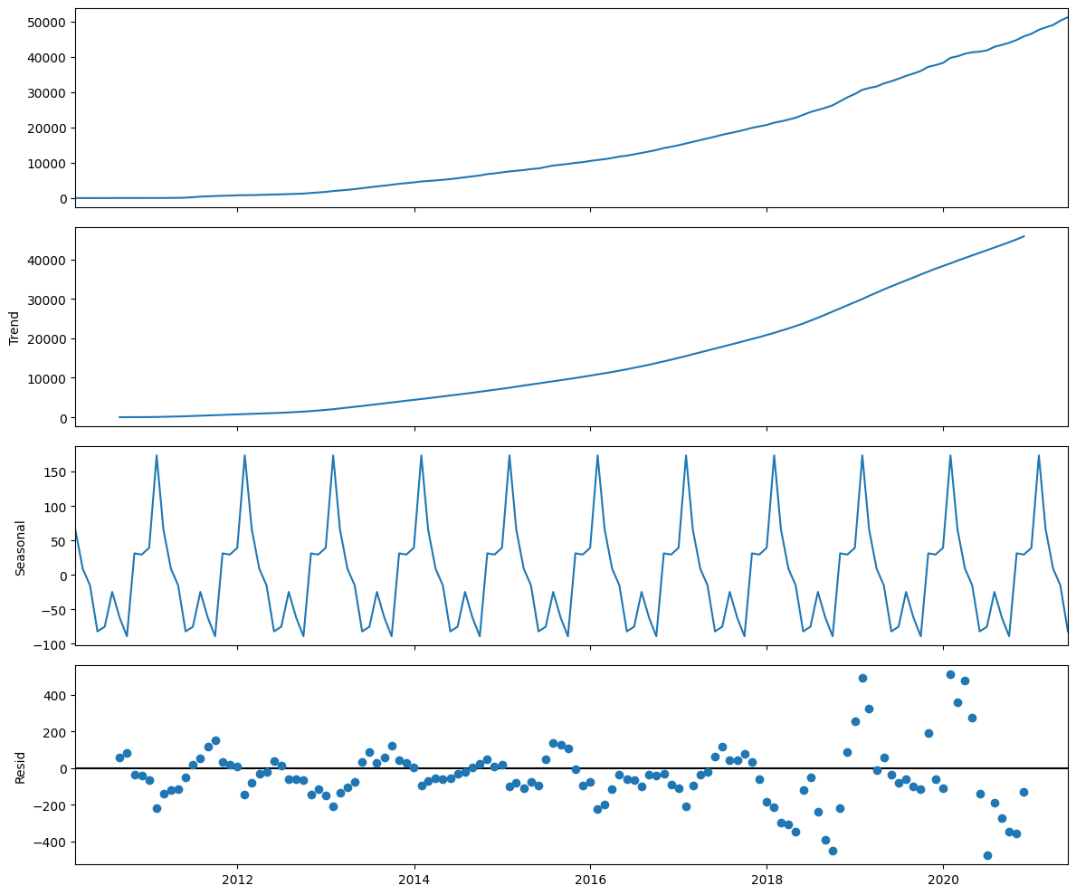
KinG County
Not surprisingly, the electric vehicle count for King County has an upward trend. Additionally, we can see that there is seasonality to the data as well. We can now move onto creating the training and testing sets for validation.
After multiple iterations, we found that the 0.80-0.20 split of the data belonging to King County resulted in the best performance.

Slide 19
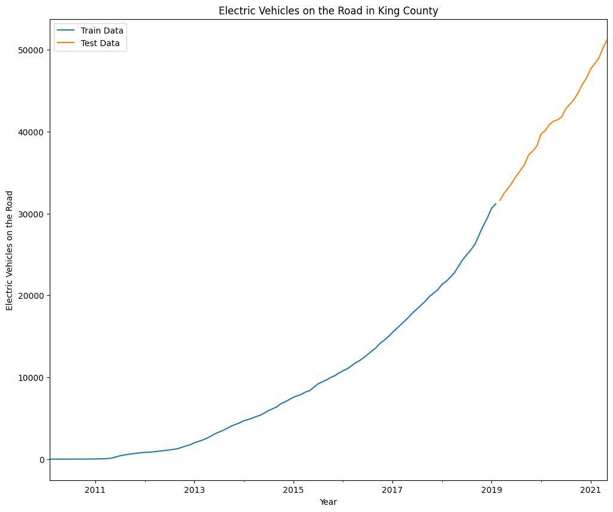
Electric Vehicles on the road in king county
After multiple iterations, we found that the 0.80-0.20 split of the data belonging to King County resulted in the best performance.
To have a model that can accurately predict future values, we need to optimize the p,d,q values of the models for each county and validate. In order to achieve this programmatically, we will be using the pmdarima library.
train_test_split

Slide 20
Validate Model with Forecasts for Test Data
Future Predictions
Here, looking at the residual information, we can see that they are very close to having a normal distribution. Additionally, there is no longer an obvious seasonality based on the correlogram and the standardized residuals. The coefficient p-values also suggest that they are statistically significant. These results suggest that the model is satisfactory to move onto validation.
Above, we can see that the model is able to accurately forecast data into the future. The actual observed data is well within the confidence interval of our model's forecasts.
Now that we know that our model can accurately make predictions about the future electric vehicle counts in each county, we can use the same parameters to build a model on the whole observed dataset without splitting it into train/test sets.

Slide 21
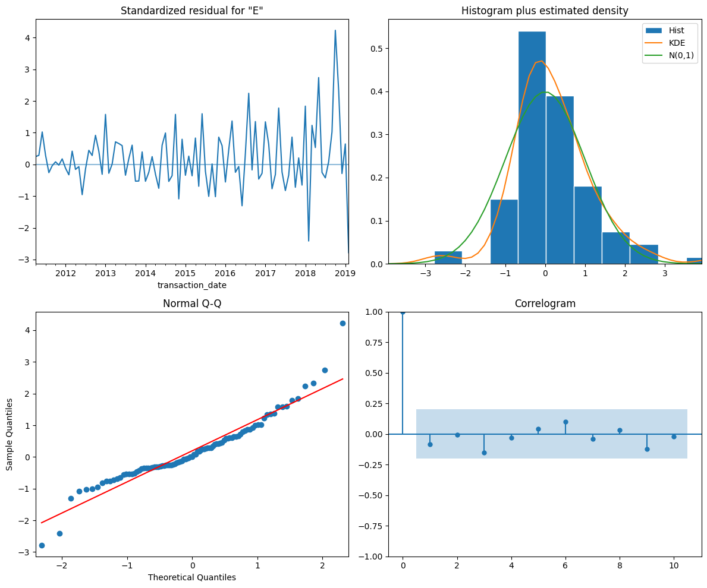

Slide 22
Future Predictions
Here, looking at the residual information, we can see that they are very close to having a normal distribution. Additionally, there is no longer an obvious seasonality based on the correlogram and the standardized residuals. The coefficient p-values also suggest that they are statistically significant. These results suggest that the model is satisfactory to move onto validation.
Above, we can see that the model is able to accurately forecast data into the future. The actual observed data is well within the confidence interval of our model's forecasts.
Above we can see that the residuals for this model are less normally distributed compared to the test model. However, they are still fairly close to having a normal distribution. Additionally, there is no longer an obvious seasonality based on the correlogram and the standardized residuals. The coefficient p-values also suggest that they are statistically significant.

Slide 23
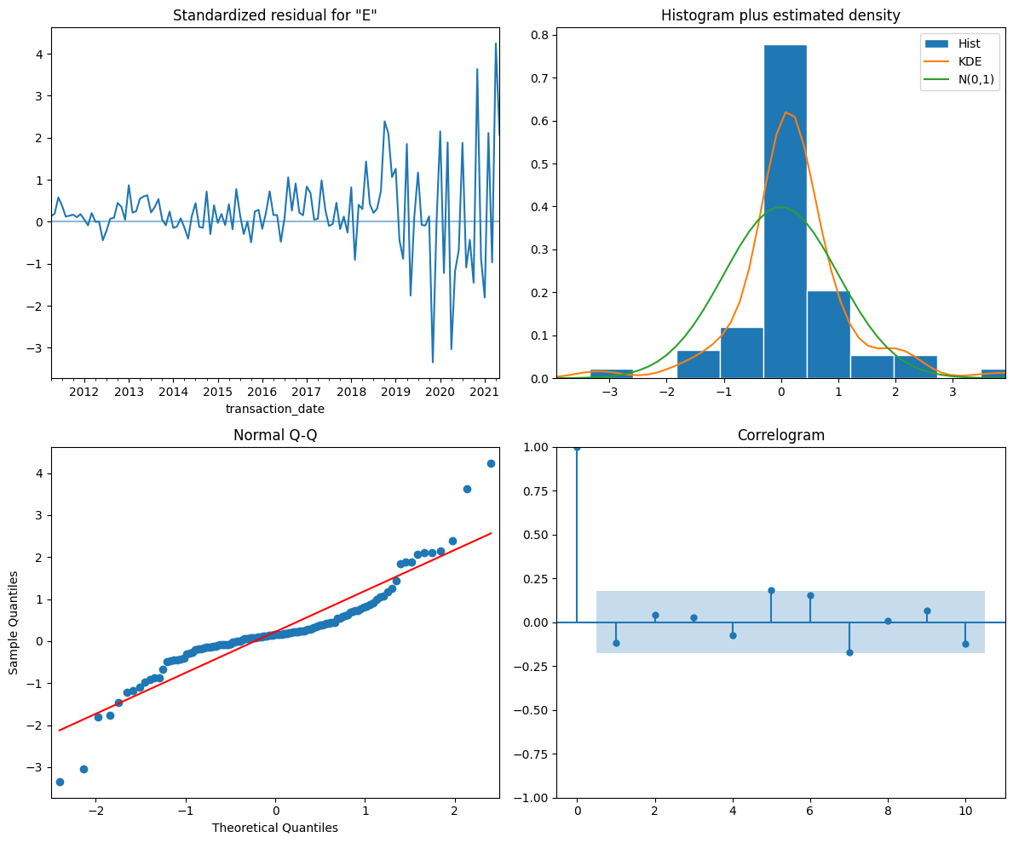
Future Predictions
Fiitng model to all observed data

Slide 24
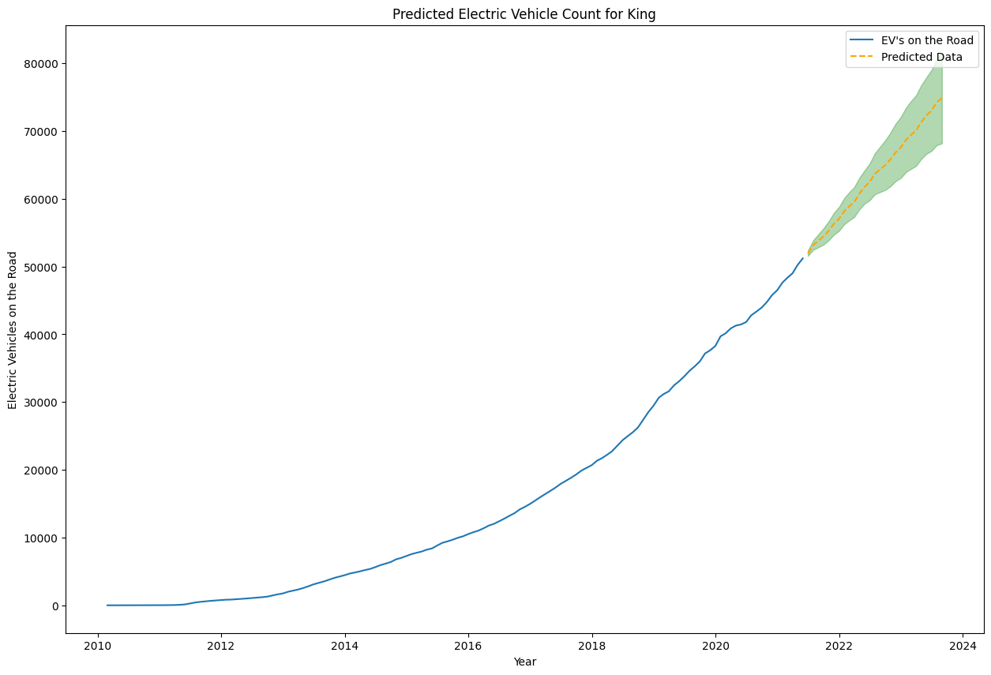

Slide 25
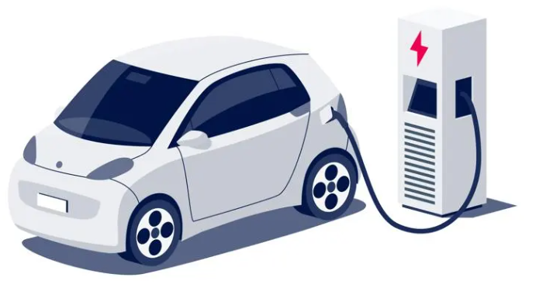
Conclusion
The model is predicting that the amount of electric vehicles in King County are going to keep increasing almost linearly based on the mean values. If we look at the upper confidence interval though, we can see that the increase could keep an exponential pattern.

Slide 26
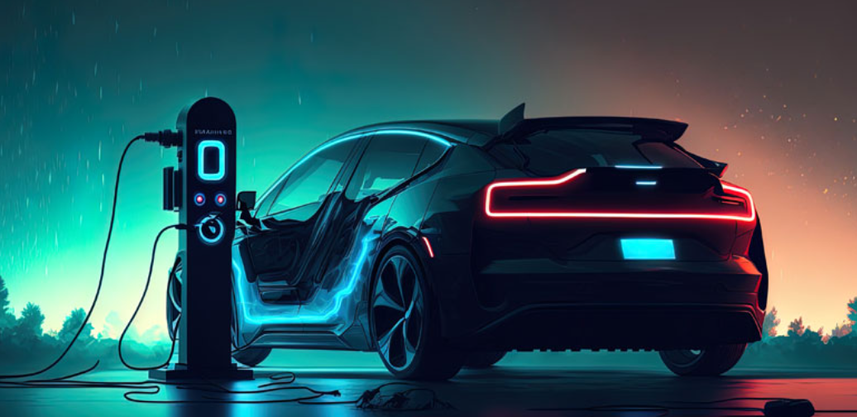
THANK YOU
Tarun Varma Mudunuri
Muhammad Hamid Ahmed Dastgir
Ravikiran Sriram
Jagan Galla
m

